Slide 1
Chapter 7
The American Revolution
(1774-1783)

Slide 2
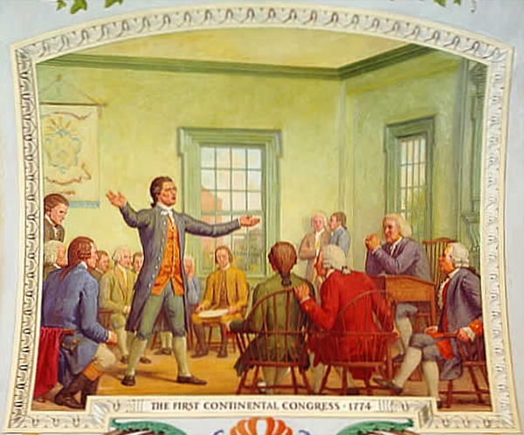
Section 1: The Revolution Begins
The first Continental Congress (1774)
  Met in Philadelphia
  G.A. only colony not represented
  Issue: How to respond to events in Boston
  Solution:
    Continue to BOYCOTT British goods
    Warned Colonial MILITIAS to be prepared to fight
    Sent a Declaration of Rights to King George III
      List of freedoms they felt they possessed

Slide 3
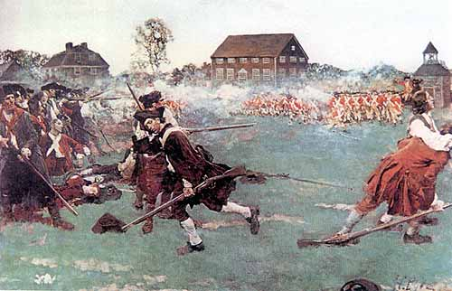
The “Shot” Heard round the World”
Militias in Boston start calling themselves “minutemen”
  Read to fight in a minute
1775 – Gen. THOMAS GAGE wants militias’ weapons – plans operation
  Weapons stored in CONCORD, MA
  Sons of Liberty learn of plan
    S.O.L. tell PAUL REVERE
      Rides through countryside
        “The British are coming, the British are coming”
    MINUTEMEN meet British at LEXINGTON, MA (near Concord)
      Someone fires a shot, colonists killed
  British march to Concord – no weapons found – they retreat back to Boston
    Colonists follow them – snipe at REDCOATS (British soldiers) from behind
      Many killed

Slide 4
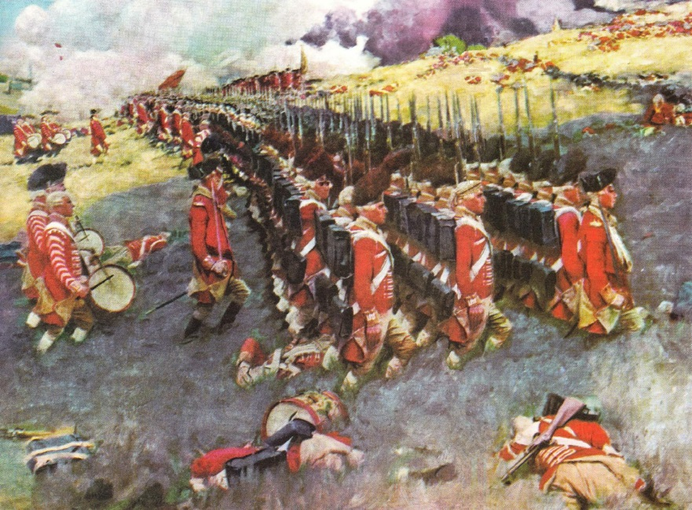
Early Battles
1775
  Minutemen hold Boston under SEIGE
    Situation in which soldiers surround a fort
    British plan to take Charlestown (area overlooks Boston)
      Colonial forces prepared – turn back assault
        BATTLE OF BUNKER HILL
          1,000 dead British
    1776 – colonists take back Boston

Slide 5
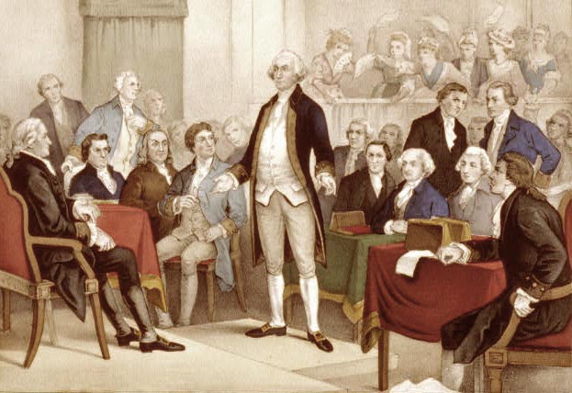
Section 1 (continued): The Second Continental Congress
Second Continental Congress (1775)
  Goal: decide how to respond to fighting
    Decided not to break away from Britain
    Made plans to create CONTINENTAL ARMY to defend colonies
      GEORGE WASHINGTON (V.A.) put in command
    Final attempt at peace
      OLIVE BRANCH PETITION
        Attempt to make peace with Britain
        Rejected by King George III

Slide 6
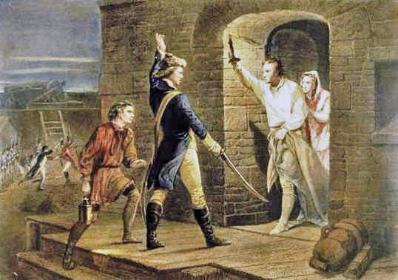
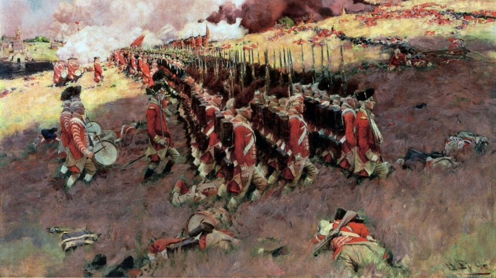
Early Battles
Benedict Arnold and Ethan Allen – Generals in Continental Army
  Capture Fort Ticonderoga in upstate New York (1775)
Boston under SIEGE
  Situation in which soldiers surround a city or fort
  BATTLE OF BUNKER HILL
    Cannons from Fort Ticonderoga used to force British out of city

Slide 7
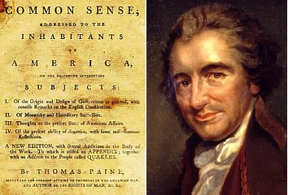
Section 2 – Declaring Independence
THOMAS PAINE
  Mr. Novick’s favorite American philosopher!!!
  Failure in Britain
    Comes to America at 38 years old
    1776 – Pamphlet – COMMON SENSE
      argued for break with Britain
      Written in common language
        Radical idea of pamphlet
          Monarchy, itself, immoral
        Gained more supporters for revolution against Britain

Slide 8
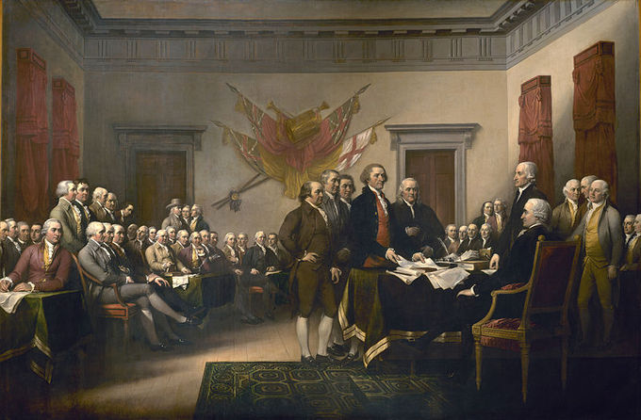
Declaring Independence (continued)
1776
  S.C.C. creates committee
    Drafts independence document
      THOMAS JEFFERSON (V. A.) main author
        Key ides
          All men possess UNALIENABLE RIGHTS
            “Life, liberty, and the pursuit of happiness”
              Inspired by philosophy of the Enlightenment
                18th century intellectual movement in Europe
              King George III violated these rights - broke SOCIAL CONTRACT – what is it???
                Colonies had right to break way
      July 4, 1776 – SCC approves DECLARATION OF INDEPENDENCE
        United States of America born

Slide 9
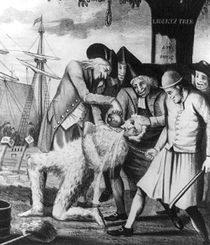
Choosing Sides
Colonists who wanted to fight for independence
  PATRIOTS
Colonists who wanted to remain loyal to Great Britain
  LOYALISTS, or TORIES
    100,000 had to flee to Canada!
Choosing neither side
  NEUTRAL

Slide 10
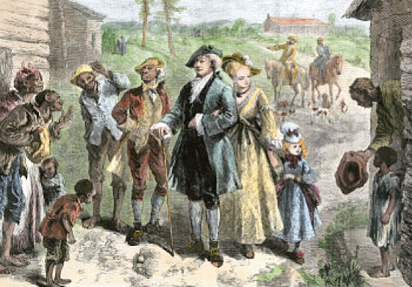
Other Reactions to the Declaration of Independence
“all men are created equal”
  Equal for all?
    Document did not mention women at all
      Worried educated women like ABIGAIL ADAMS, wife of John Adams
    Did not mention African-Americans
      In 1776 slavery legal in all colonies
      In first draft Jefferson wrote negatively about slave trade
        Forced to take it out
          Southerners against it

Slide 11
Section 3: Dark Hours of the Revolution
- Strengths and Weaknesses
British
  More money and resources
  Powerful military
  Navy
    Largest in world
  Soldiers
    Well-trained professionals
  Forced to deal with hostile citizens
  Forced to ship supplies across Atlantic Ocean
  Forced to use MERCENERIES
    Hired foreign soldiers
Patriots
  No navy at beginning
  Army
    Poorly-trained local militias
    Never fought together before
  Had many people on their side
  Fighting for a cause they believed in

Slide 12
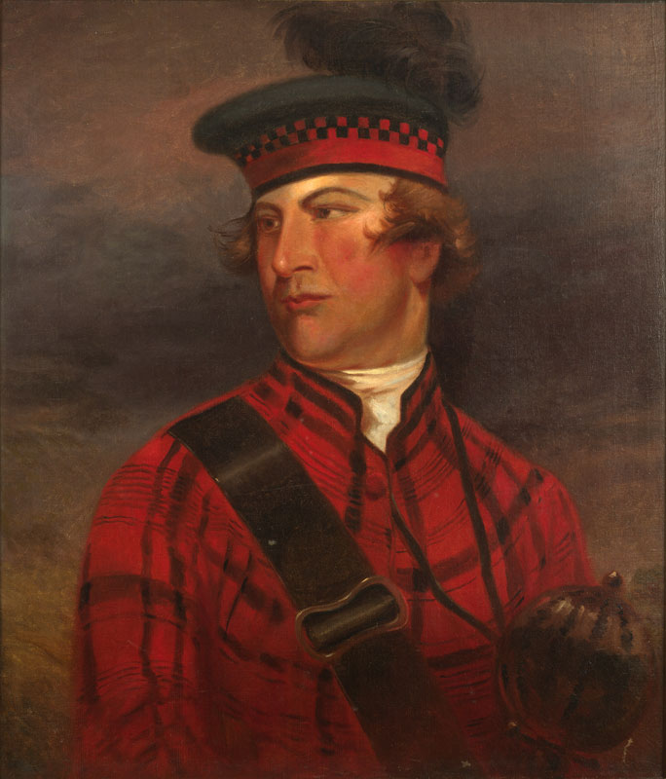
A Call to Arms
Blacks
  Continental Army banned them
  LORD DUNMORE’S PROCLAMATION
    British promised freedom to any slave who fought for them
Indians
  Fought on both sides
  THAYENDANEGEA (Joseph Brant)
    Mohawk leader
      Key ally of British
Women
  Many helped Patriot cause
    MOLLY PITCHER (Mary Ludwig Hays)
      Loaded cannons/brought water
    Deborah Sampson
      Disguised herself as a man – fought in war

Slide 13
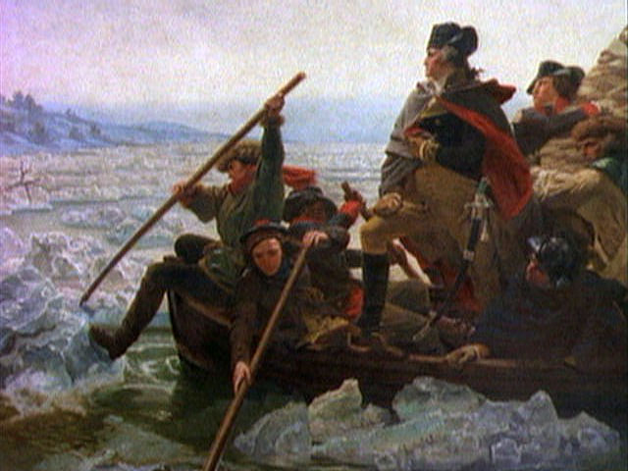
British Victories and Patriot New Hope
Patriots fail to take Quebec
GENERAL HOWE
  Drives Continental Army off Long Island
    Forces Washington to keep retreating
    Leaves New Jersey in the hands of HESSIANS
BATTLE OF TRENTON
  Mr. Novick is from Washington Crossing, P.A. so you better remember this!!!
  Surprises Hessians after crossing Delaware River Christmas night
BATTLE OF PRINCETON
  Washington wins again nearby

Slide 14
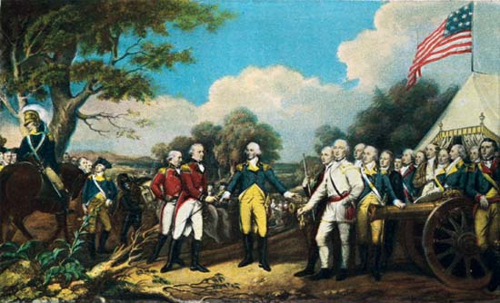
Turning Point at Saratoga
Plan to have General BURGOYNE meet up with Howe near Albany
  Howe late
    But defeats Washington at BATTLE OF BRANDYWINE CREEK
      Many Patriots escape
    Burgoyne reaches Albany outnumbered
      BATTLE OF SARATOGA
        Burgoyne surrenders whole army to GENERAL HORATIO GATES

Slide 15
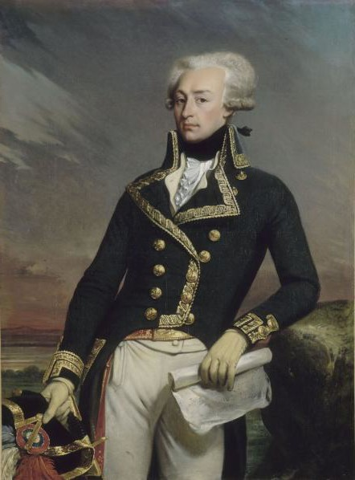
Foreign Allies
Following Saratoga
  France joins war, later Spain
  Spain
    Help from BERNARDO DE GALVEZ, Governor of Spanish Louisiana
  France
    MARQUIS DE LAFAYETTE
      Nobleman who came to fight for Patriot cause
      Close with Washington
      Gave tons of money to support Revolution
  Poland
    Tadeusz Kosciuszko
      Helped with army engineering and cavalry units

Slide 16
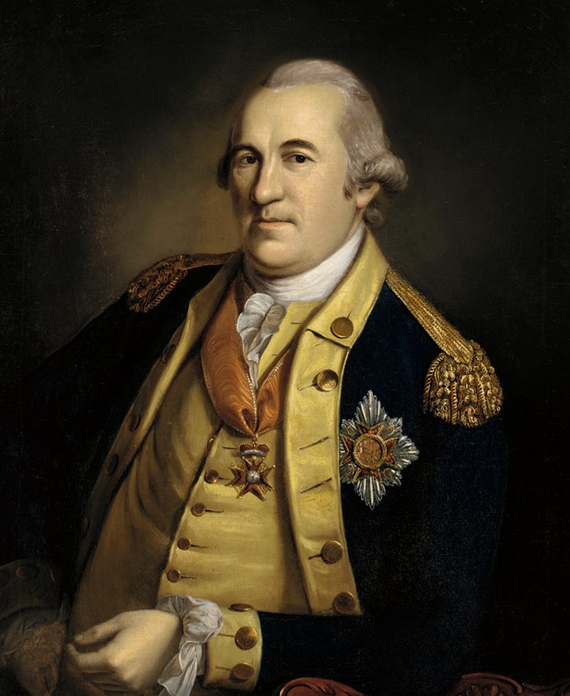
Winter at Valley Forge
Winter, 1777
  Washington settles troops at Valley Forge, P. A.
    1/5 died from harsh winter, disease, lack of supplies
      Troops close to mutiny until arrival of FRIEDRICH VON STEUBEN
        Prussian office
          Spoke no English
          Taught drilling – made soldiers well-trained
Patriot Navy
  Role of JOHN PAUL JONES
    Captured many British ships
    Created small, effective force

Slide 17
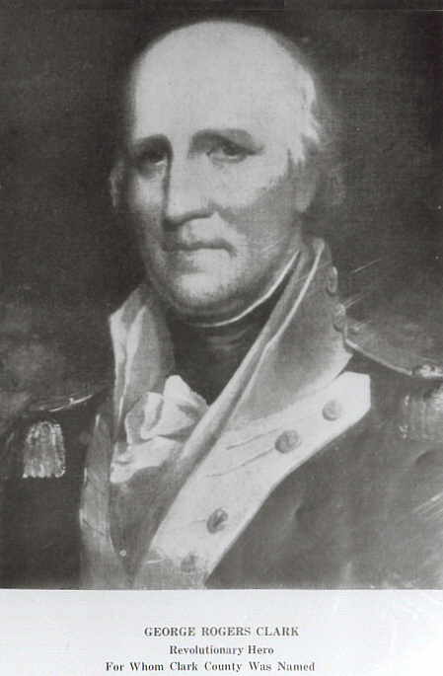
War in the West & South
West
  GEORGE ROGERS CLARK
    Frontiersman who took town of Vincennes at BATTLE OF VINCENNES
      Weakened British Army in West
South
  HORATIO GATES fails to take back South Carolina from British
    Switch to guerilla warfare
      FRANCIS MARION
        “the swamp fox”
          Use tactics to fight British

Slide 18
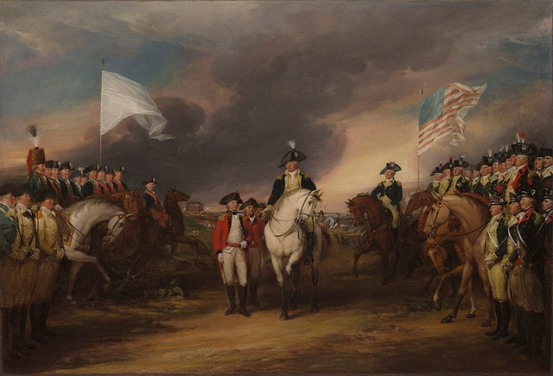
Victory at Yorktown
1781
  BENEDICT ARNOLD switches sides
  British control most of South
  YORKTOWN
    GENERAL CORNWALLIS moves into Virginia
      Prepares attack on LAFAYETTE
    Washington plans with French general, COMTE DE ROCHAMBEAU
      French fleet traps Cornwallis in Chesapeake Bay
      Combined Patriot-French forces move South (double size of British)
        Lay siege to Yorktown
          Cornwallis surrenders

Slide 19
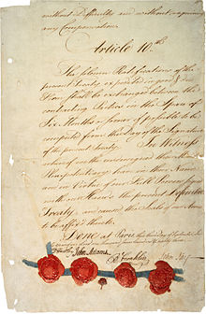
Treaty of Paris
1781
  Peace negotiations begin
    Continental Congress w/ British
      Adams, Franklin, John Jay, and others
      Took 2 years for an agreement
Treaty
  G. B. recognizes new United States
    Borders
      Western border – Mississippi R.
      31 N Latitude Southern border
      Acceptance of Americans settling, trading West of 13 colonies

